Slide 1
Finite State Machines
Sequential circuits
  primitive sequential elements
  combinational logic
Models for representing sequential circuits
  finite-state machines (Moore and Mealy)
Basic sequential circuits revisited
  shift registers
  counters
Design procedure
  state diagrams
  state transition table
  next state functions
Hardware description languages

Slide 2
Abstraction of state elements
Divide circuit into combinational logic and state
Localize the feedback loops and make it easy to break cycles
Implementation of storage elements leads to various forms of sequential logic
Inputs
Combinational
Logic
Outputs
State Inputs
State Outputs
Storage Elements

Slide 3
Forms of sequential logic
Asynchronous sequential logic – state changes occur whenever state inputs change (elements may be simple wires or delay elements)
Synchronous sequential logic – state changes occur in lock step across all storage elements (using a periodic waveform - the clock)
Clock

Slide 4
Finite state machine representations
States: determined by possible values in sequential storage elements
Transitions: change of state
Clock: controls when state can change by controlling storage elements
Sequential logic
  sequences through a series of states
  based on sequence of values on input signals
  clock period defines elements of sequence
001
010
111
In = 1
In = 0
In = 0
100
110
In = 1

Slide 5
Example finite state machine diagram
Combination lock from introduction to course
  5 states
  5 self-transitions
  6 other transitions between states
  1 reset transition (from all states) to state S1
ERR
closed
not equal
& new
not equal
& new
not equal
& new
S1
S2
S3
OPEN
reset
closed
mux=C1
closed
mux=C2
closed
mux=C3
open
equal
& new
equal
& new
equal
& new
not new
not new
not new

Slide 6
Can any sequential system be represented with a state diagram?
Shift register
  input value shown
  on transition arcs
  output values shown
  within state node
OUT1
OUT2
OUT3
IN
D
Q
D
Q
D
Q
CLK
100
1
110
1
0
1
1
1
0
000
1
010
101
0
111
1
0
0
1
0
0
001
0
011

Slide 7
Counters are simple finite state machines
Counters
  proceed through well-defined sequence of states in response to enable
Many types of counters: binary, BCD, Gray-code
  3-bit up-counter: 000, 001, 010, 011, 100, 101, 110, 111, 000, ...
  3-bit down-counter: 111, 110, 101, 100, 011, 010, 001, 000, 111, ...
001
010
011
000
3-bit up-counter
100
111
110
101

Slide 8
How do we turn a state diagram into logic?
Counter
  3 flip-flops to hold state
  logic to compute next state
  clock signal controls when flip-flop memory can change
    wait long enough for combinational logic to compute new value
    don't wait too long as that is low performance
OUT1
OUT2
OUT3
D
Q
D
Q
D
Q
CLK
"1"

Slide 9
FSM design procedure
Start with counters
  simple because output is just state
  simple because no choice of next state based on input
State diagram to state transition table
  tabular form of state diagram
  like a truth-table
State encoding
  decide on representation of states
  for counters it is simple: just its value
Implementation
  flip-flop for each state bit
  combinational logic based on encoding

Slide 10
FSM design procedure: state diagram to encoded state transition table
Tabular form of state diagram
Like a truth-table (specify output for all input combinations)
Encoding of states: easy for counters – just use value
present state next state
0 000 001 1
1 001 010 2
2 010 011 3
3 011 100 4
4 100 101 5
5 101 110 6
6 110 111 7
7 111 000 0
001
010
011
000
3-bit up-counter
100
111
110
101

Slide 11
Implementation
D flip-flop for each state bit
Combinational logic based on encoding
Verilog notation to show
function represents an
input to D-FF
C3 C2 C1 N3 N2 N1
0 0 0 0 0 1
0 0 1 0 1 0
0 1 0 0 1 1
0 1 1 1 0 0
1 0 0 1 0 1
1 0 1 1 1 0
1 1 0 1 1 1
1 1 1 0 0 0
N1 <= C1’
N2 <= C1C2’ + C1’C2
<= C1 xor C2
N3 <= C1C2C3’ + C1’C3 + C2’C3
<= (C1C2)C3’ + (C1’ + C2’)C3
<= (C1C2)C3’ + (C1C2)’C3
<= (C1C2) xor C3
N3
C3
N2
C3
N1
C3
0 0
0 1
1 1
0 1
0 1
1 0
1 0
0 1
1 1
0 0
1 1
0 0
C1
C1
C1
C2
C2
C2

Slide 12
Back to the shift register
Input determines next state
In C1 C2 C3 N1 N2 N3
0 0 0 0 0 0 0
0 0 0 1 0 0 0
0 0 1 0 0 0 1
0 0 1 1 0 0 1
0 1 0 0 0 1 0
0 1 0 1 0 1 0
0 1 1 0 0 1 1
0 1 1 1 0 1 1
1 0 0 0 1 0 0
1 0 0 1 1 0 0
1 0 1 0 1 0 1
1 0 1 1 1 0 1
1 1 0 0 1 1 0
1 1 0 1 1 1 0
1 1 1 0 1 1 1
1 1 1 1 1 1 1
100
1
110
1
0
1
1
1
0
000
1
010
101
0
111
1
0
0
0
1
0
001
0
011
N1 <= In
N2 <= C1
N3 <= C2
OUT1
OUT2
OUT3
IN
D
Q
D
Q
D
Q
CLK

Slide 13
More complex counter example
Complex counter
  repeats 5 states in sequence
  not a binary number representation
Step 1: derive the state transition diagram
  count sequence: 000, 010, 011, 101, 110
Step 2: derive the state transition table from the state transition diagram
000
110
Present State Next State
C B A C+ B+ A+
0 0 0 0 1 0
0 0 1 – – –
0 1 0 0 1 1
0 1 1 1 0 1
1 0 0 – – –
1 0 1 1 1 0
1 1 0 0 0 0
1 1 1 – – –
010
101
011
note the don't care conditions that arise from the unused state codes

Slide 14
More complex counter example (cont’d)
Step 3: K-maps for next state functions
C+
C
B+
C
A+
C
0 0
X 1
0 X
X 1
1 1
X 0
0 X
X 1
0 1
X 1
0 X
X 0
A
A
A
B
B
B
C+ <= A
B+ <= B’ + A’C’
A+ <= BC’

Slide 15
Self-starting counters (cont’d)
Re-deriving state transition table from don't care assignment
C+
C
B+
C
A+
C
0 0
1 1
0 0
1 1
1 1
1 0
0 1
0 1
0 1
0 1
0 0
0 0
A
A
A
B
B
B
111
001
Present State Next State
C B A C+ B+ A+
0 0 0 0 1 0
0 0 1 1 1 0
0 1 0 0 1 1
0 1 1 1 0 1
1 0 0 0 1 0
1 0 1 1 1 0
1 1 0 0 0 0
1 1 1 1 0 0
000
110
100
010
101
011

Slide 16
Self-starting counters
Start-up states
  at power-up, counter may be in an unused or invalid state
  designer must guarantee that it (eventually) enters a valid state
Self-starting solution
  design counter so that invalid states eventually transition to a valid state
  may limit exploitation of don't cares
001
111
111
implementation
on previous slide
001
000
110
000
110
100
100
010
101
010
101
011
011

Slide 17
Activity
2-bit up-down counter (2 inputs)
  direction: D = 0 for up, D = 1 for down
  count: C = 0 for hold, C = 1 for count
S1 S0 C D N1 N0
0 0 0 0 0 0
0 0 0 1 0 0
0 0 1 0 0 1
0 0 1 1 1 1
0 1 0 0 0 1
0 1 0 1 0 1
0 1 1 0 1 0
0 1 1 1 0 0
1 0 0 0 1 0
1 0 0 1 1 0
1 0 1 0 1 1
1 0 1 1 0 1
1 1 0 0 1 1
1 1 0 1 1 1
1 1 1 0 0 0
1 1 1 1 1 0
C=0
D=X
C=0
D=X
C=1
D=0
00
11
C=1
D=0
C=1
D=1
C=1
D=0
01
10
C=1
D=0
C=0
D=X
C=0
D=X

Slide 18
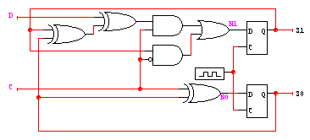
Activity (cont’d)
S1
S1 S0 C D N1 N0
0 0 0 0 0 0
0 0 0 1 0 0
0 0 1 0 0 1
0 0 1 1 1 1
0 1 0 0 0 1
0 1 0 1 0 1
0 1 1 0 1 0
0 1 1 1 0 0
1 0 0 0 1 0
1 0 0 1 1 0
1 0 1 0 1 1
1 0 1 1 0 1
1 1 0 0 1 1
1 1 0 1 1 1
1 1 1 0 0 0
1 1 1 1 1 0
0 0 1 1
0 0 1 1
1 0 1 0
0 1 0 1
N1 = C’S1
+ CDS0’S1’ + CDS0S1
+ CD’S0S1’ + CD’S0’S1
= C’S1
+ C(D’(S1 ⊕ S0) + D(S1 ≡ S0))
D
C
S0
S1
0 1 1 0
0 1 1 0
1 0 0 1
1 0 0 1
N0 = CS0’ + C’S0
D
C
S0

Slide 19
Counter/shift-register model
Values stored in registers represent the state of the circuit
Combinational logic computes:
  next state
    function of current state and inputs
  outputs
    values of flip-flops
next state
logic
Inputs
Next State
Current State
Outputs

Slide 20
General state machine model
Values stored in registers represent the state of the circuit
Combinational logic computes:
  next state
    function of current state and inputs
  outputs
    function of current state and inputs (Mealy machine)
    function of current state only (Moore machine)
output
logic
Outputs
Inputs
next state
logic
Next State
Current State

Slide 21
State machine model (cont’d)
States: S₁, S₂, ..., S_{k}
Inputs: I₁, I₂, ..., I_{m}
Outputs: O₁, O₂, ..., O_{n}
Transition function: F_{s}(S_{i}, I_{j})
Output function: F_{o}(S_{i}) or F_{o}(S_{i}, I_{j})
output
logic
Outputs
Inputs
next state
logic
Next State
Current State
Next State
State
Clock
0
1
2
3
4
5

Slide 22
Comparison of Mealy and Moore machines
Mealy machines tend to have less states
  different outputs on arcs (n²) rather than states (n)
Moore machines are safer to use
  outputs change at clock edge (always one cycle later)
  in Mealy machines, input change can cause output change as soon as logic is done – a big problem when two machines are interconnected – asynchronous feedback may occur if one isn’t careful
Mealy machines react faster to inputs
  react in same cycle – don't need to wait for clock
  in Moore machines, more logic may be necessary to decode state into outputs – more gate delays after clock edge

Slide 23
Comparison of Mealy and Moore machines (cont’d)
Moore
Mealy
Synchronous Mealy
inputs
combinational
logic for
next state
reg
logic for
outputs
outputs
state feedback
inputs
logic for
outputs
outputs
combinational
logic for
next state
reg
state feedback
inputs
logic for
outputs
outputs
combinational
logic for
next state
reg
state feedback

Slide 24
Specifying outputs for a Moore machine
Output is only function of state
  specify in state bubble in state diagram
  example: sequence detector for 01 or 10
current next
reset input state state output
1 – – A
0 0 A B 0
0 1 A C 0
0 0 B B 0
0 1 B D 0
0 0 C E 0
0 1 C C 0
0 0 D E 1
0 1 D C 1
0 0 E B 1
0 1 E D 1
0
1
B/0
D/1
0
reset
0
A/0
1
0
1
1
C/0
E/1
0
1

Slide 25
Specifying outputs for a Mealy machine
Output is function of state and inputs
  specify output on transition arc between states
  example: sequence detector for 01 or 10
0/0
current next
reset input state state output
1 – – A 0
0 0 A B 0
0 1 A C 0
0 0 B B 0
0 1 B C 1
0 0 C B 1
0 1 C C 0
B
0/0
reset/0
A
0/1
1/1
1/0
C
1/0

Slide 26
Registered Mealy machine (really Moore)
Synchronous (or registered) Mealy machine
  registered state AND outputs
  avoids ‘glitchy’ outputs
  easy to implement in PLDs
Moore machine with no output decoding
  outputs computed on transition to next state rather than after entering
  view outputs as expanded state vector
output
logic
Outputs
Inputs
next state
logic
Current State

Slide 27
Example: vending machine
Release item after 15 cents are deposited
Single coin slot for dimes, nickels
No change
Reset
N
Vending
Machine
FSM
Open
Coin
Sensor
Release
Mechanism
D
Clock

Slide 28
Example: vending machine (cont’d)
Suitable abstract representation
  tabulate typical input sequences:
    3 nickels
    nickel, dime
    dime, nickel
    two dimes
  draw state diagram:
    inputs: N, D, reset
    output: open chute
  assumptions:
    assume N and D asserted
    for one cycle
    each state has a self loop
    for N = D = 0 (no coin)
Reset
S0
N
D
S1
S2
N
D
N
D
S3
S4
[open]
S5
[open]
S6
[open]
N
D
S7
[open]
S8
[open]

Slide 29
Example: vending machine (cont’d)
Minimize number of states - reuse states whenever possible
Reset
present inputs next output
state D N state open
0¢ 0 0 0¢ 0
0 1 5¢ 0
1 0 10¢ 0
1 1 – –
5¢ 0 0 5¢ 0
0 1 10¢ 0
1 0 15¢ 0
1 1 – –
10¢ 0 0 10¢ 0
0 1 15¢ 0
1 0 15¢ 0
1 1 – –
15¢ – – 15¢ 1
0¢
N
5¢
D
N
D
10¢
N + D
15¢
[open]
symbolic state table

Slide 30
Example: vending machine (cont’d)
Uniquely encode states
present state inputs next state output
Q1 Q0 D N D1 D0 open
0 0 0 0 0 0 0
0 1 0 1 0
1 0 1 0 0
1 1 – – –
0 1 0 0 0 1 0
0 1 1 0 0
1 0 1 1 0
1 1 – – –
1 0 0 0 1 0 0
0 1 1 1 0
1 0 1 1 0
1 1 – – –
1 1 – – 1 1 1

Slide 31
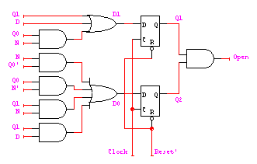
Example: Moore implementation
Mapping to logic
D1
Q1
D0
Q1
Open
Q1
0 0 1 1
0 1 1 1
X X 1 X
1 1 1 1
0 1 1 0
1 0 1 1
X X 1 X
0 1 1 1
0 0 1 0
0 0 1 0
X X 1 X
0 0 1 0
N
N
N
D
D
D
Q0
Q0
Q0
D1 = Q1 + D + Q0 N
D0 = Q0’ N + Q0 N’ + Q1 N + Q1 D
OPEN = Q1 Q0

Slide 32
Example: vending machine (cont’d)
One-hot encoding
present state inputs next state output
Q3 Q2 Q1 Q0 D N D3 D2 D1 D0 open
0 0 0 1 0 0 0 0 0 1 0
0 1 0 0 1 0 0
1 0 0 1 0 0 0
1 1 - - - - -
0 0 1 0 0 0 0 0 1 0 0
0 1 0 1 0 0 0
1 0 1 0 0 0 0
1 1 - - - - -
0 1 0 0 0 0 0 1 0 0 0
0 1 1 0 0 0 0
1 0 1 0 0 0 0
1 1 - - - - -
1 0 0 0 - - 1 0 0 0 1
D0 = Q0 D’ N’
D1 = Q0 N + Q1 D’ N’
D2 = Q0 D + Q1 N + Q2 D’ N’
D3 = Q1 D + Q2 D + Q2 N + Q3
OPEN = Q3

Slide 33
Equivalent Mealy and Moore state diagrams
Moore machine
  outputs associated with state
Mealy machine
  outputs associated with transitions
Reset
N’ D’ + Reset
Reset/0
(N’ D’ + Reset)/0
0¢
[0]
0¢
N’ D’
N’ D’/0
N
N/0
D
5¢
[0]
D/0
5¢
N’ D’
N’ D’/0
N
N/0
10¢
[0]
10¢
D
N’ D’
D/1
N’ D’/0
N+D
N+D/1
15¢
[1]
15¢
Reset’
Reset’/1

Slide 34
Example: Mealy implementation
Reset/0
Reset/0
present state inputs next state output
Q1 Q0 D N D1 D0 open
0 0 0 0 0 0 0
0 1 0 1 0
1 0 1 0 0
1 1 – – –
0 1 0 0 0 1 0
0 1 1 0 0
1 0 1 1 1
1 1 – – –
1 0 0 0 1 0 0
0 1 1 1 1
1 0 1 1 1
1 1 – – –
1 1 – – 1 1 1
0¢
N’ D’/0
N/0
D/0
5¢
N’ D’/0
N/0
10¢
D/1
N’ D’/0
N+D/1
15¢
Reset’/1
Open
Q1
0 0 1 0
0 0 1 1
X X 1 X
0 1 1 1
D0 = Q0’N + Q0N’ + Q1N + Q1D
D1 = Q1 + D + Q0N
OPEN = Q1Q0 + Q1N + Q1D + Q0D
N
D
Q0

Slide 35
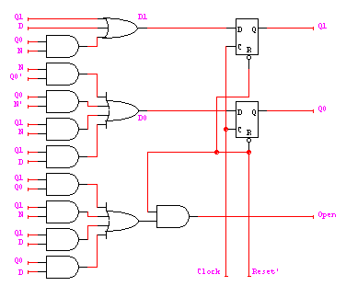
Example: Mealy implementation
D0 = Q0’N + Q0N’ + Q1N + Q1D
D1 = Q1 + D + Q0N
OPEN = Q1Q0 + Q1N + Q1D + Q0D
make sure OPEN is 0 when reset
– by adding AND gate

Slide 36
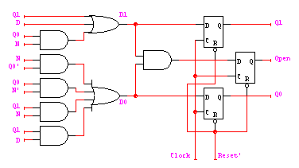
Vending machine: Moore to synch. Mealy
OPEN = Q1Q0 creates a combinational delay after Q1 and Q0 change in Moore implementation
This can be corrected by retiming, i.e., move flip-flops and logic through each other to improve delay
OPEN.d = (Q1 + D + Q0N)(Q0'N + Q0N' + Q1N + Q1D)
= Q1Q0N' + Q1N + Q1D + Q0'ND + Q0N'D
Implementation now looks like a synchronous Mealy machine
  it is common for programmable devices to have FF at end of logic

Slide 37
Vending machine: Mealy to synch. Mealy
OPEN.d = Q1Q0 + Q1N + Q1D + Q0D
OPEN.d = (Q1 + D + Q0N)(Q0'N + Q0N' + Q1N + Q1D)
= Q1Q0N' + Q1N + Q1D + Q0'ND + Q0N'D
Open.d
Q1
Open.d
Q1
0 0 1 0
0 0 1 1
1 0 1 1
0 1 1 1
0 0 1 0
0 0 1 1
X X 1 X
0 1 1 1
N
N
D
D
Q0
Q0

Slide 38
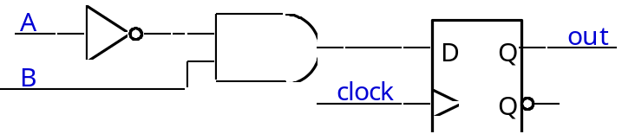
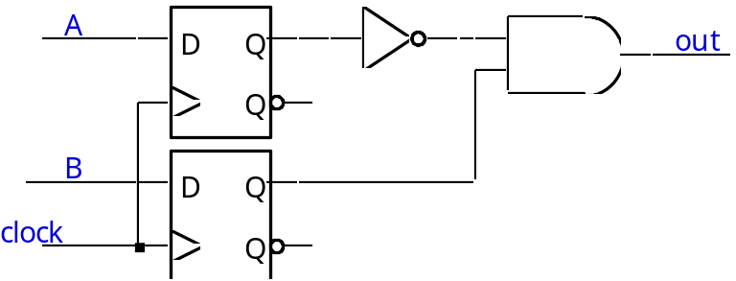
Mealy and Moore examples
Recognize A,B = 0,1
  Mealy or Moore?
A
out
B

Slide 39
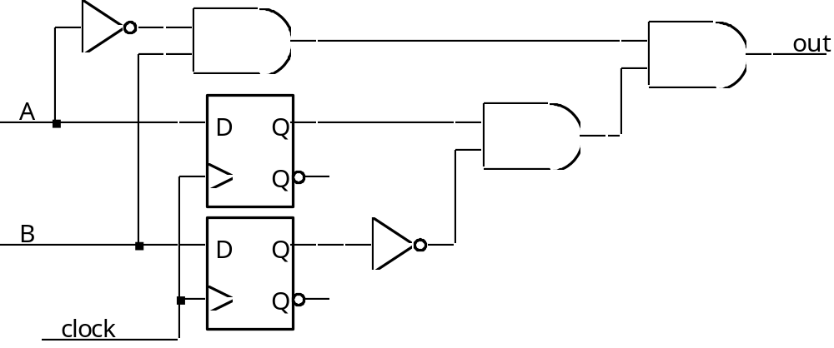
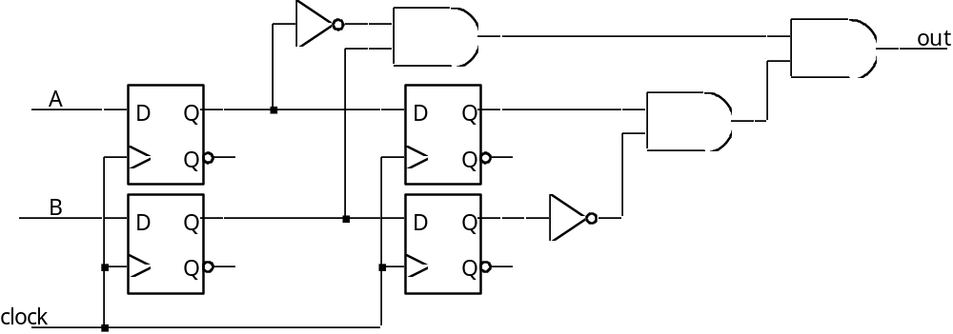
Mealy and Moore examples (cont’d)
Recognize A,B = 1,0 then 0,1
  Mealy or Moore?

Slide 40
Hardware Description Languages and Sequential Logic
Flip-flops
  representation of clocks - timing of state changes
  asynchronous vs. synchronous
FSMs
  structural view (FFs separate from combinational logic)
  behavioral view (synthesis of sequencers – not in this course)
Data-paths = data computation (e.g., ALUs, comparators) + registers
  use of arithmetic/logical operators
  control of storage elements

Slide 41
Example: reduce-1-string-by-1
Remove one 1 from every string of 1s on the input
Moore
Mealy
zero
[0]
0/0
zero
[0]
1
0
0
one1
[0]
0/0
1/0
one1
[0]
0
1
1
1/1
two1s
[1]

Slide 42
Verilog FSM - Reduce 1s example
state assignment
(easy to change,
if in one place)
Moore machine
module reduce (clk, reset, in, out);
input clk, reset, in;
output out;
parameter zero = 2’b00;
parameter one1 = 2’b01;
parameter two1s = 2’b10;
reg out;
reg [2:1] state; // state variables
reg [2:1] next_state;
always @(posedge clk)
if (reset) state = zero;
else state = next_state;
zero
[0]
1
0
0
one1
[0]
0
1
1
two1s
[1]

Slide 43
Moore Verilog FSM (cont’d)
always @(in or state)
case (state)
zero:
// last input was a zero
begin
if (in) next_state = one1;
else next_state = zero;
end
one1:
// we've seen one 1
begin
if (in) next_state = two1s;
else next_state = zero;
end
two1s:
// we've seen at least 2 ones
begin
if (in) next_state = two1s;
else next_state = zero;
end
endcase
crucial to include
all signals that are
input to state determination
note that output
depends only on state
always @(state)
case (state)
zero: out = 0;
one1: out = 0;
two1s: out = 1;
endcase
endmodule

Slide 44
Mealy Verilog FSM
module reduce (clk, reset, in, out);
input clk, reset, in;
output out;
reg out;
reg state; // state variables
reg next_state;
always @(posedge clk)
if (reset) state = zero;
else state = next_state;
always @(in or state)
case (state)
zero: // last input was a zero
begin
out = 0;
if (in) next_state = one;
else next_state = zero;
end
one: // we've seen one 1
if (in) begin
next_state = one; out = 1;
end else begin
next_state = zero; out = 0;
end
endcase
endmodule
0/0
zero
[0]
0/0
1/0
one1
[0]
1/1

Slide 45
Synchronous Mealy Machine
module reduce (clk, reset, in, out);
input clk, reset, in;
output out;
reg out;
reg state; // state variables
always @(posedge clk)
if (reset) state = zero;
else
case (state)
zero: // last input was a zero
begin
out = 0;
if (in) state = one;
else state = zero;
end
one: // we've seen one 1
if (in) begin
state = one; out = 1;
end else begin
state = zero; out = 0;
end
endcase
endmodule

Slide 46
Finite state machines summary
Models for representing sequential circuits
  abstraction of sequential elements
  finite state machines and their state diagrams
  inputs/outputs
  Mealy, Moore, and synchronous Mealy machines
Finite state machine design procedure
  deriving state diagram
  deriving state transition table
  determining next state and output functions
  implementing combinational logic
Hardware description languages

